Slide 1

Project Professional 2016 Reporting
Presented by
Hari Prasad Thapliyal
Agilest & Project Management Trainer, Coach & Consultant
(MBA, MCA, PGDOM, PGDFM, CIC, PMP, PMI-ACP, CSM, SCPO, SDC
PRINCE2-Trainer, Scrum Certified Trainer, Microsoft Certified Trainer, ZED Master Trainer)
Hari Thapliyal

Slide 2
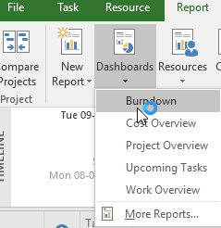

Slide 3
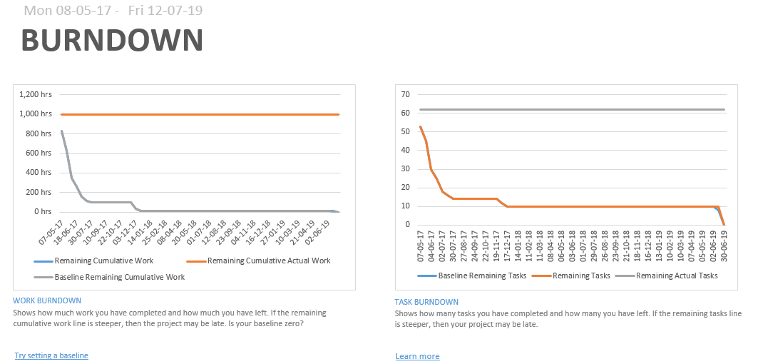
Burndown Report

Slide 4
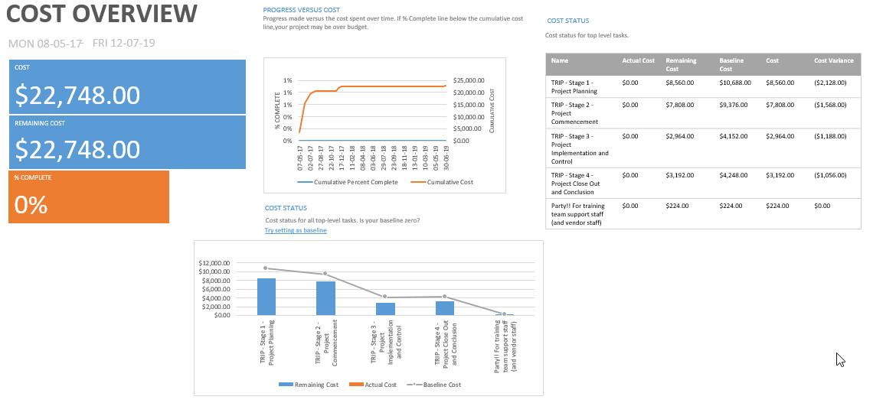
Cost Overview Report

Slide 5
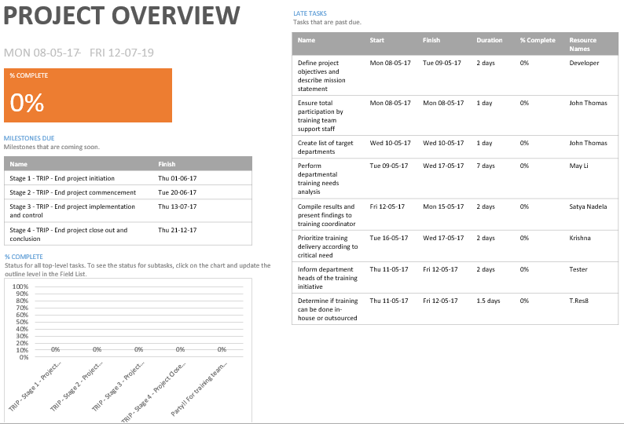
Project Overview Report

Slide 6
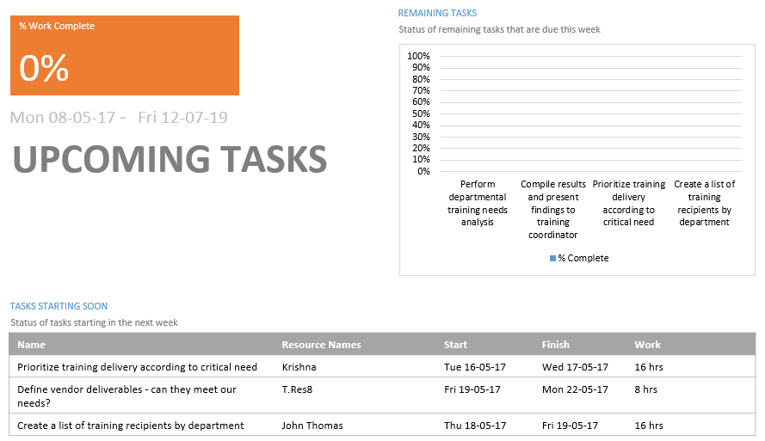
Upcoming Tasks Report

Slide 7
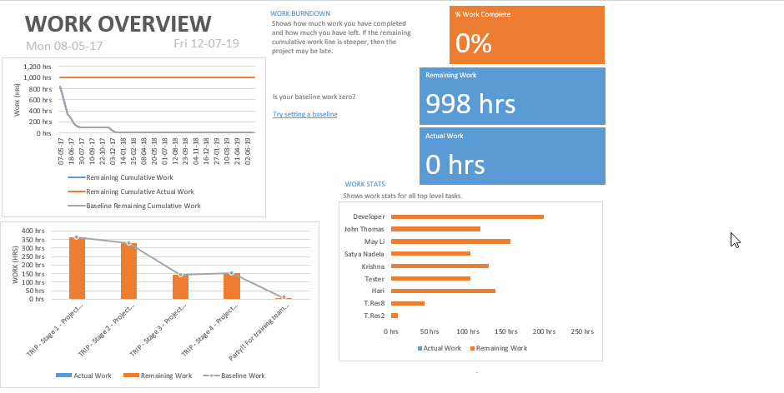
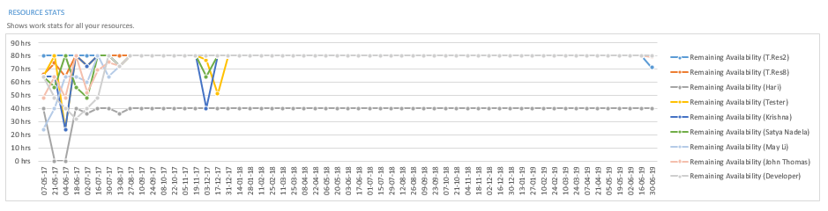
Work Overview Report

Slide 8
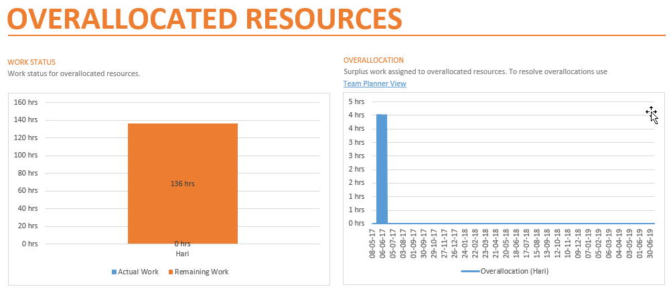
Overallocated Resources

Slide 9
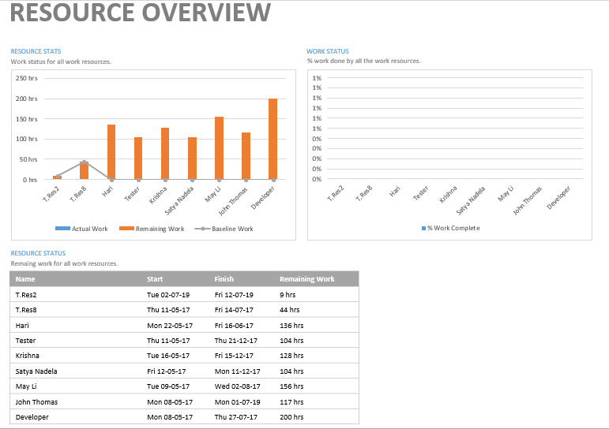
Resource Overview

Slide 10
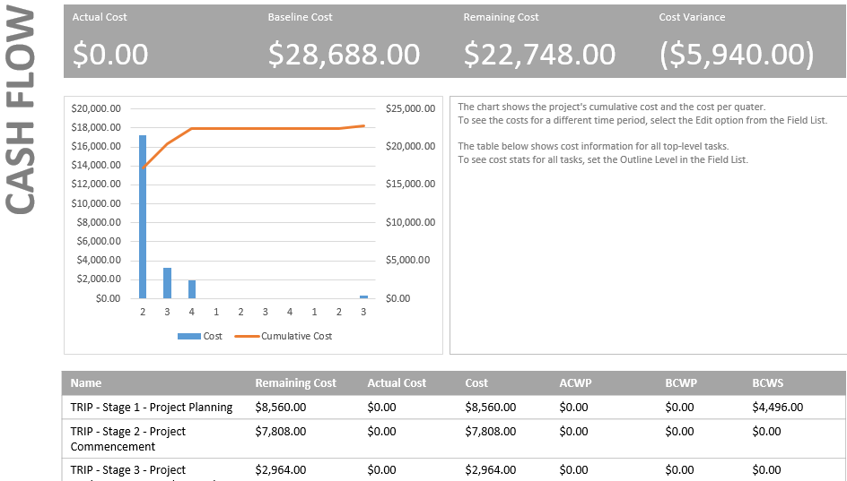
Cash Flow

Slide 11
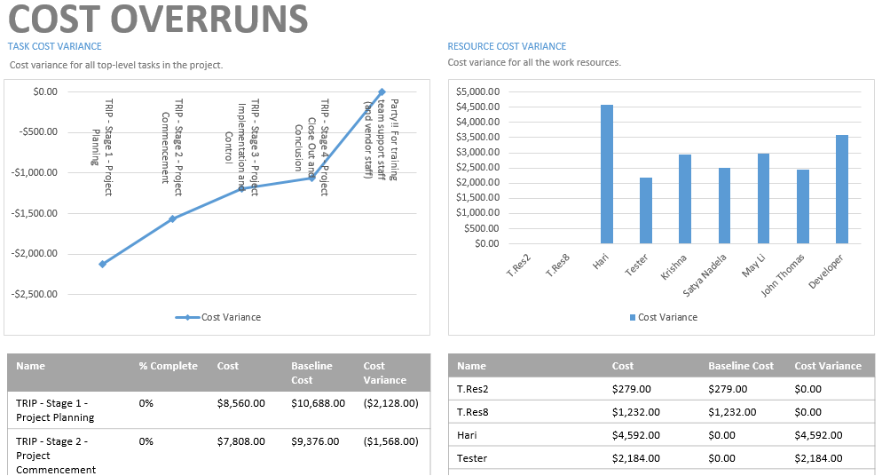
Project Professional - Training-Rollout-Initiative

Slide 12
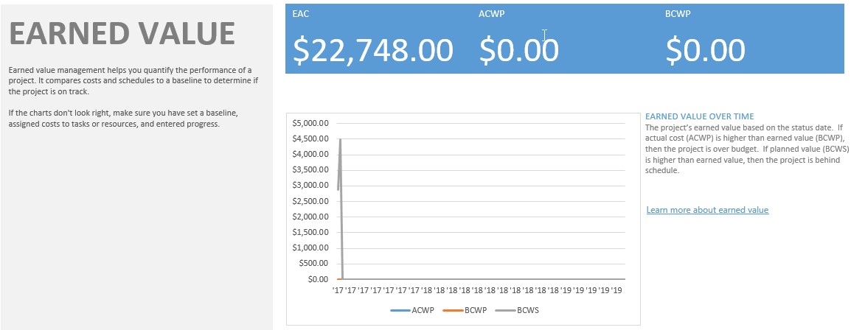
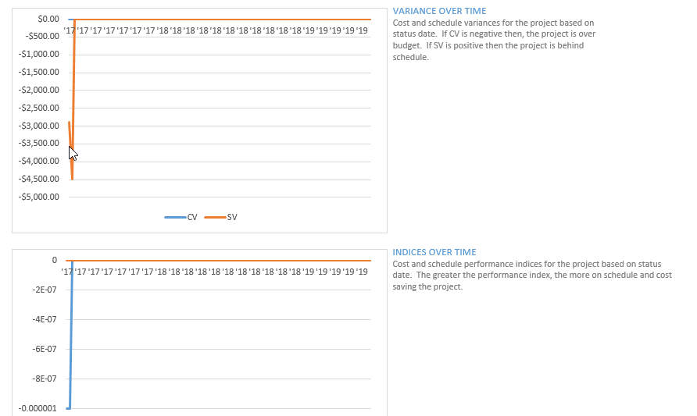
Earned Value Report

Slide 13
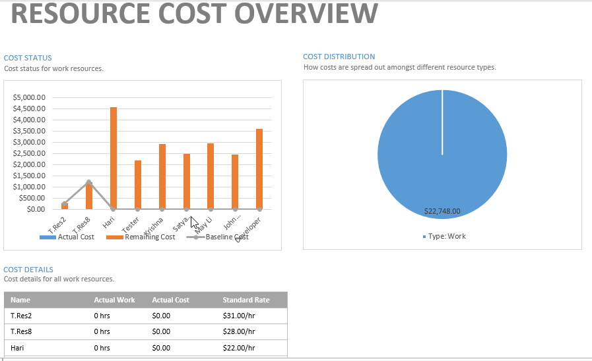
Resource Cost Overview

Slide 14
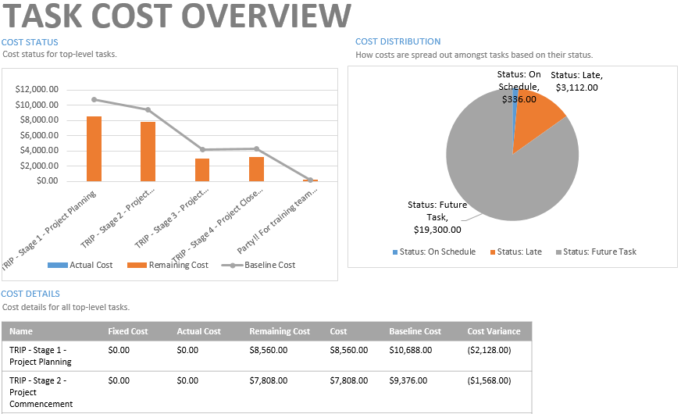
Task Cost Overview

Slide 15
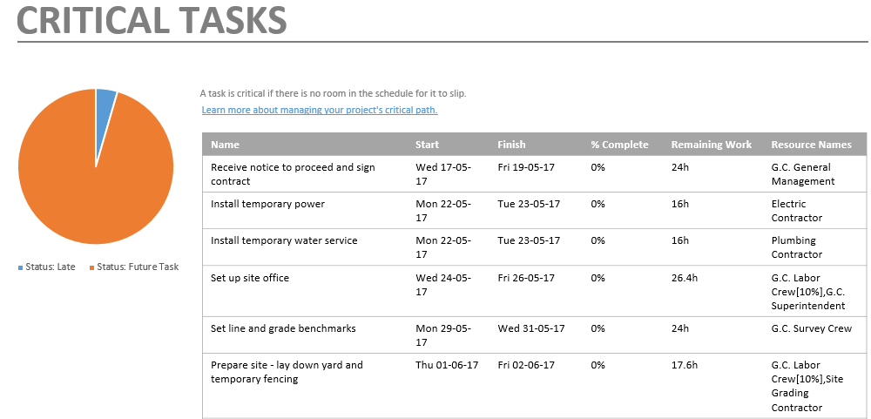
Critical Tasks

Slide 16
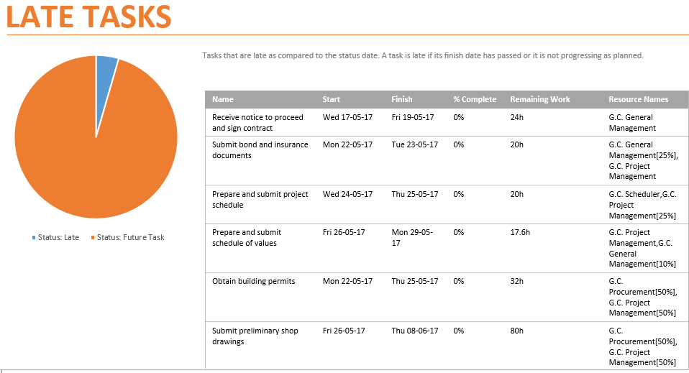
Late Tasks

Slide 17
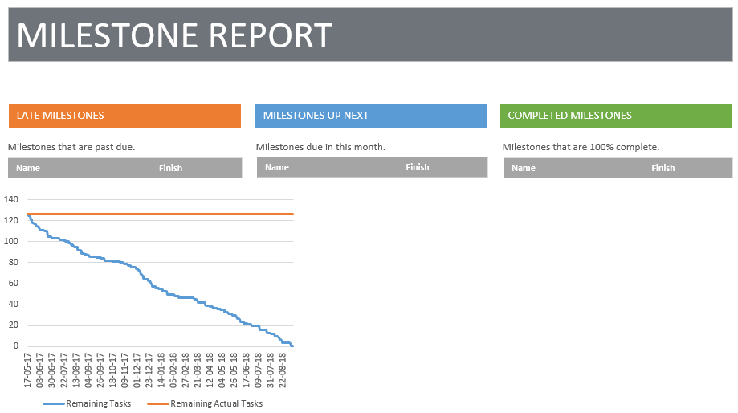
Milestone Report

Slide 18
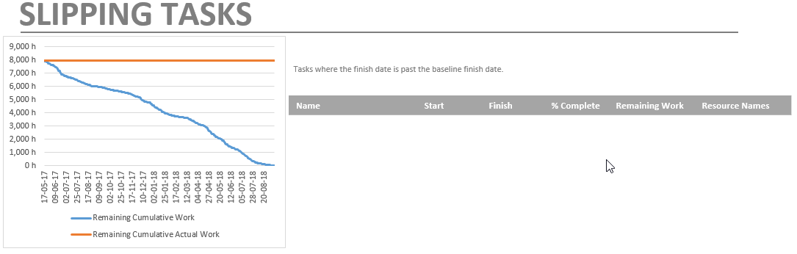
Slipping Tasks

Slide 19
Visual Reports
OLAP Cube Based

Slide 20
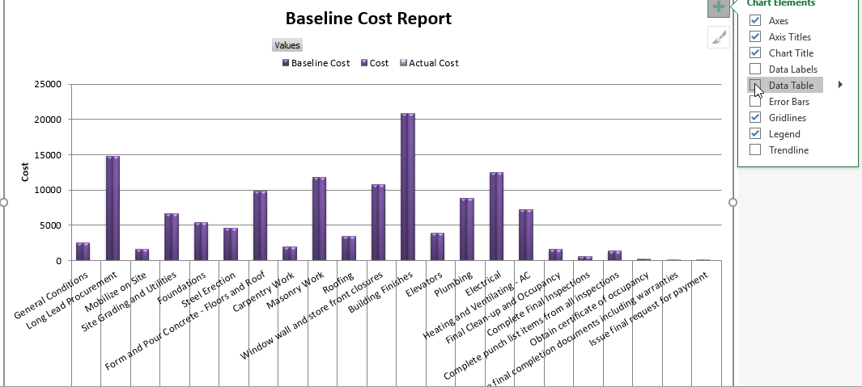
Baseline Cost Report

Slide 21
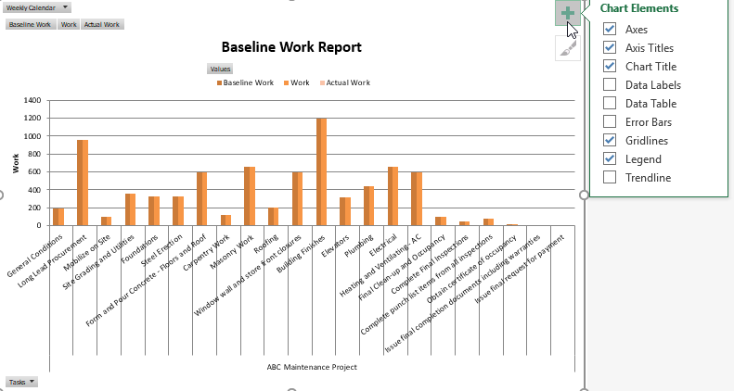
Baseline Work Report

Slide 22
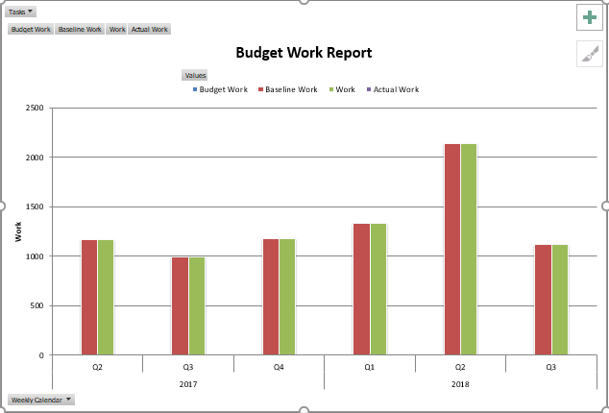
Budget Work Report

Slide 23
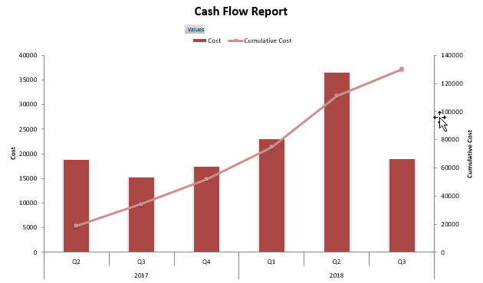
Cash Flow Report

Slide 24
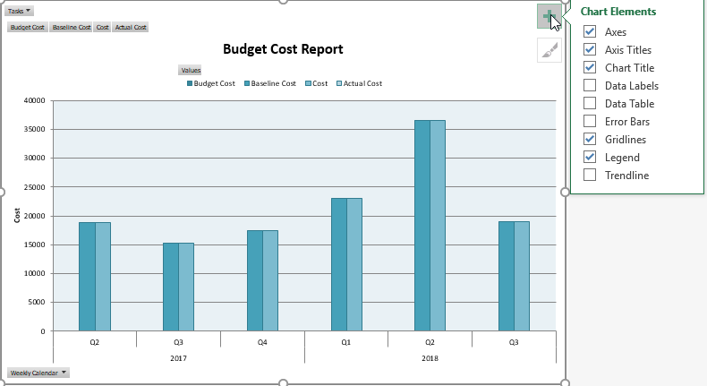
Budget Cost Report

Slide 25
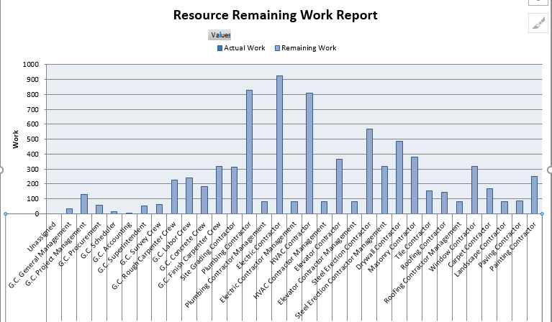
Resource Remaining Work Report

Slide 26
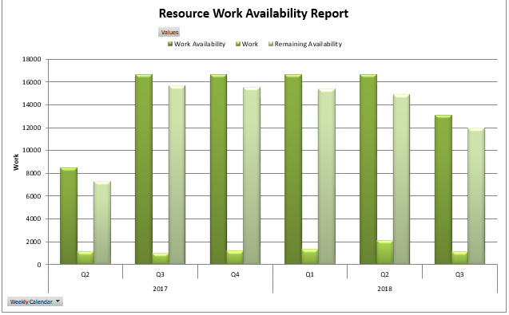
Resource Work Availability Report

Slide 27
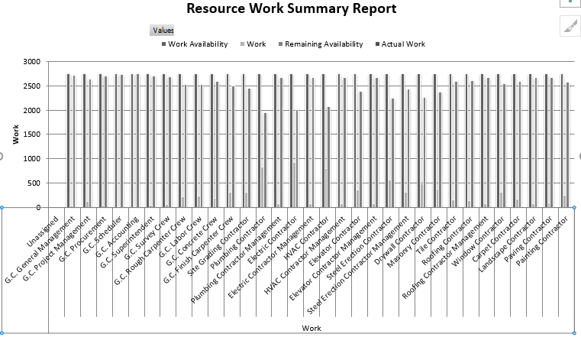
Resource Work Summary Report

Slide 28
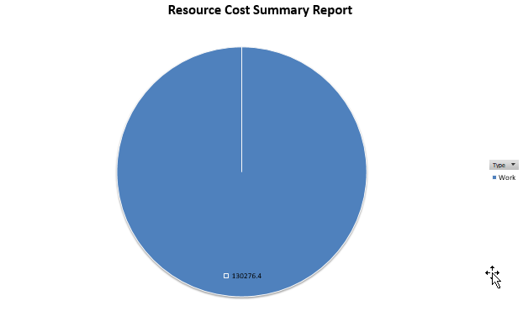
Resource Cost Summary Report

Slide 29
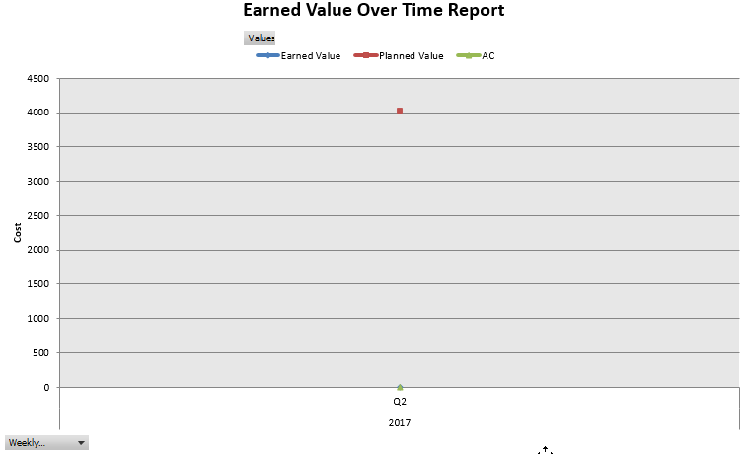
Earned Value Over Time

Slide 30
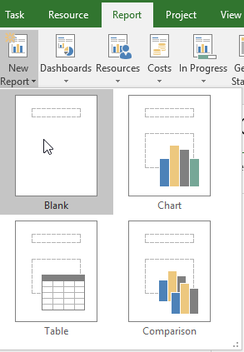
You can create your own report

Slide 31








hari.prasad@vedavit-ps.com
+91 9535999336
https://in.pinterest.com/harithapliyal
https://www.instagram.com/thapliyal.h
https://in.linkedin.com/in/harithapliyal
http://twitter.com/pmlogy
http://pmlogy.com/
http://facebook.com/harithapliyalpage

